Slide 1



AUTONOMOUS SHIPPING Sprint 3
Jasper Vlaar, Jelte Molenaar, Job Vink, Michiel van Soest en Martin de Rijke

Slide 2
Topics
Sprint
Approach
Research

Slide 3
Sprint
Research
Water detection in a maritime environment
Horizon detection in a maritime environment

Slide 4
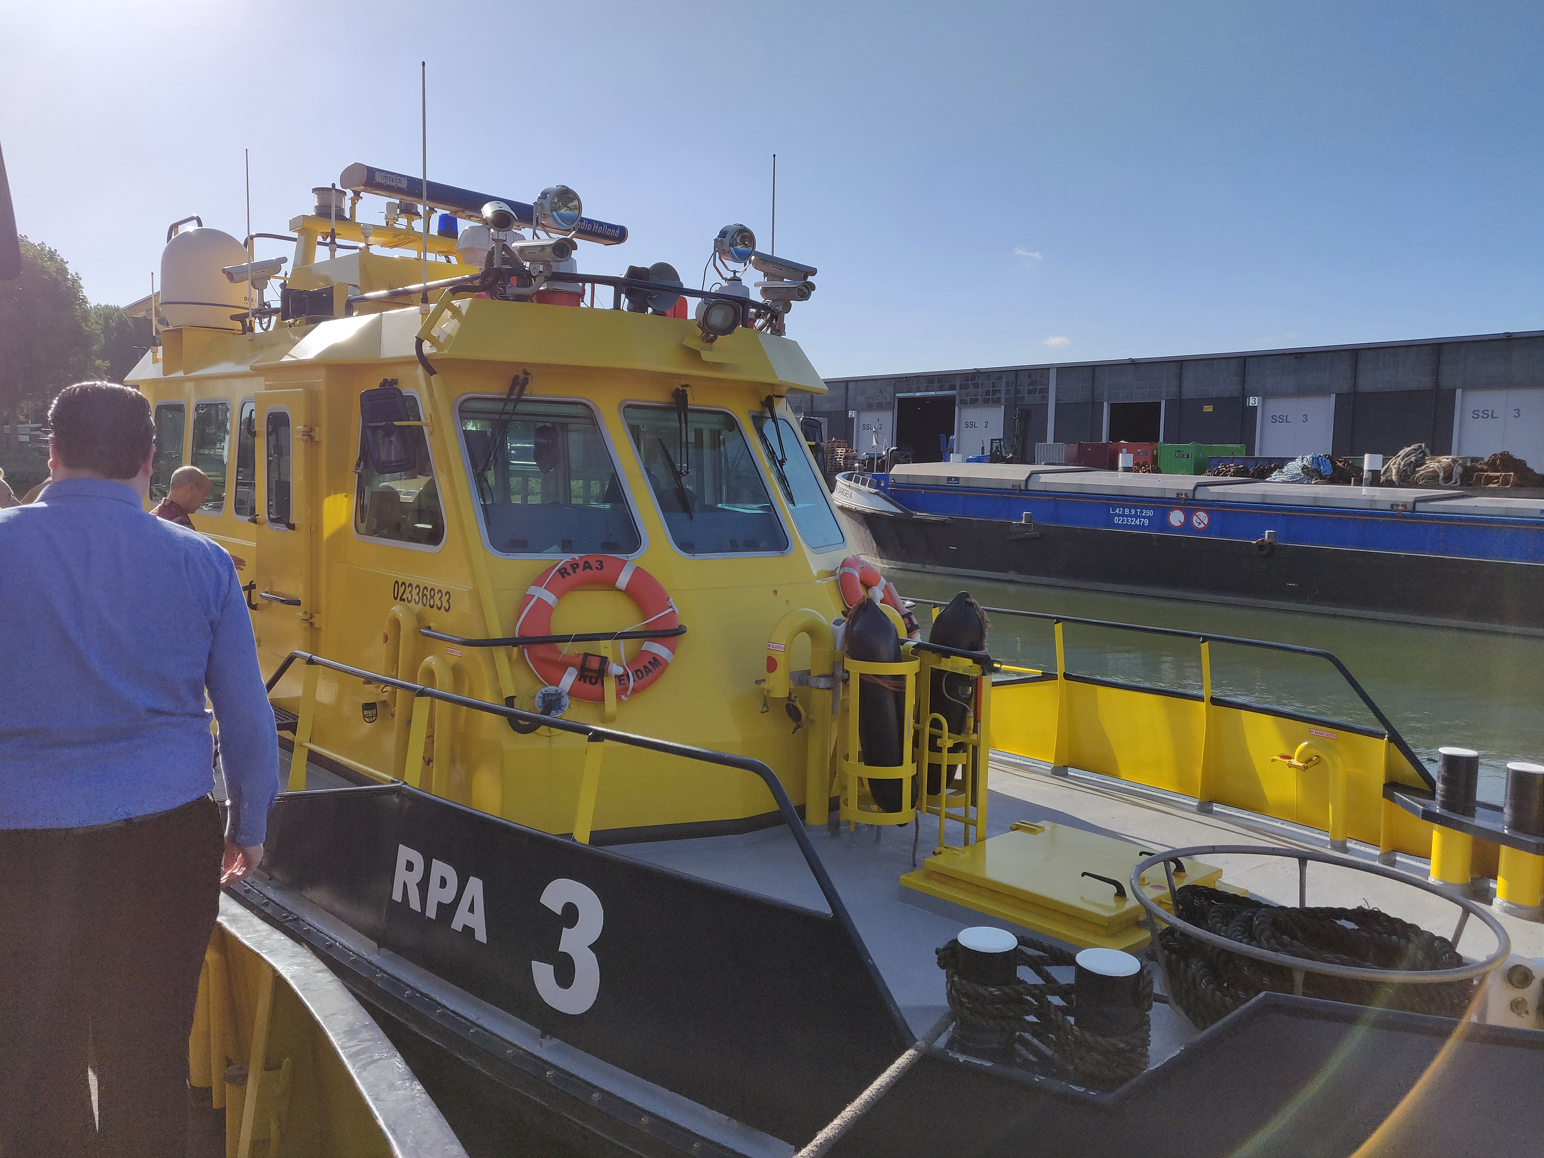
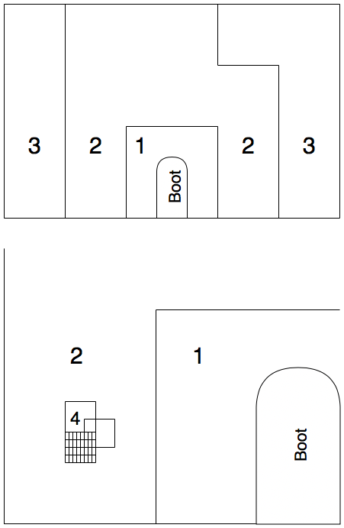
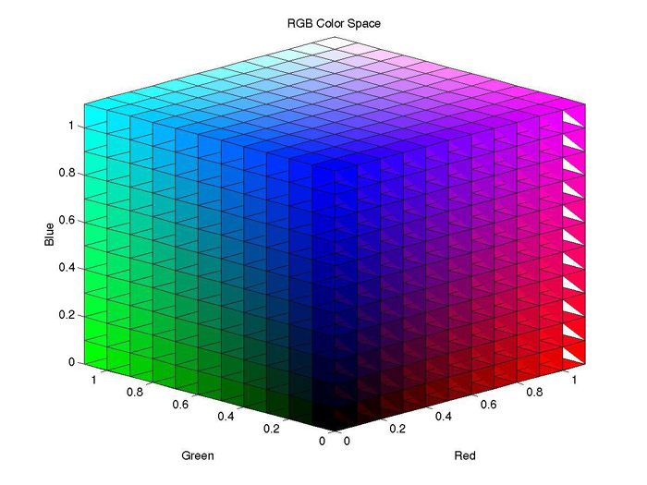
Approach

Slide 5
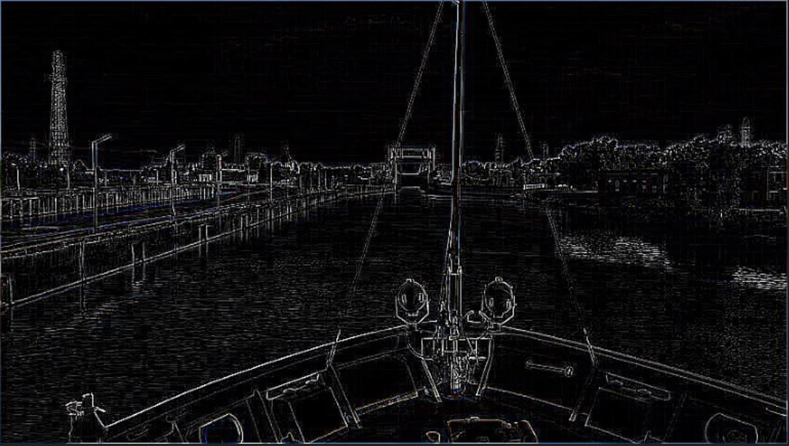
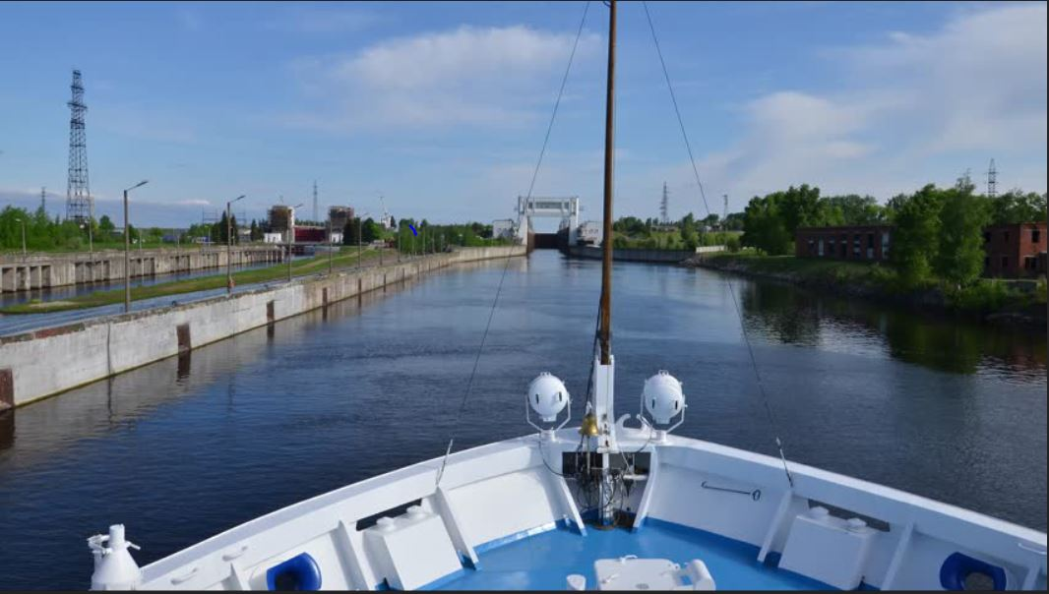
Components of the algorithm
Image preprocessing
Edge detection
Mean pixel values

